Slide 1
Climate Leader Communities Orleans Lisa Sullivan, Regional Coordinator & Michael Rossi, PSD on behalf of Mass Save October 15, 2025
COMMONWEALTH OF MASSACHUSETTS
DEPARTMENT OF ENERGY RESOURCES
Maura Healey, Governor
Kim Driscoll , Lt. Governor
Rebecca Tepper, Secretary
Elizabeth Mahony, Commissioner
Joanne Bissetta, Director

Slide 2
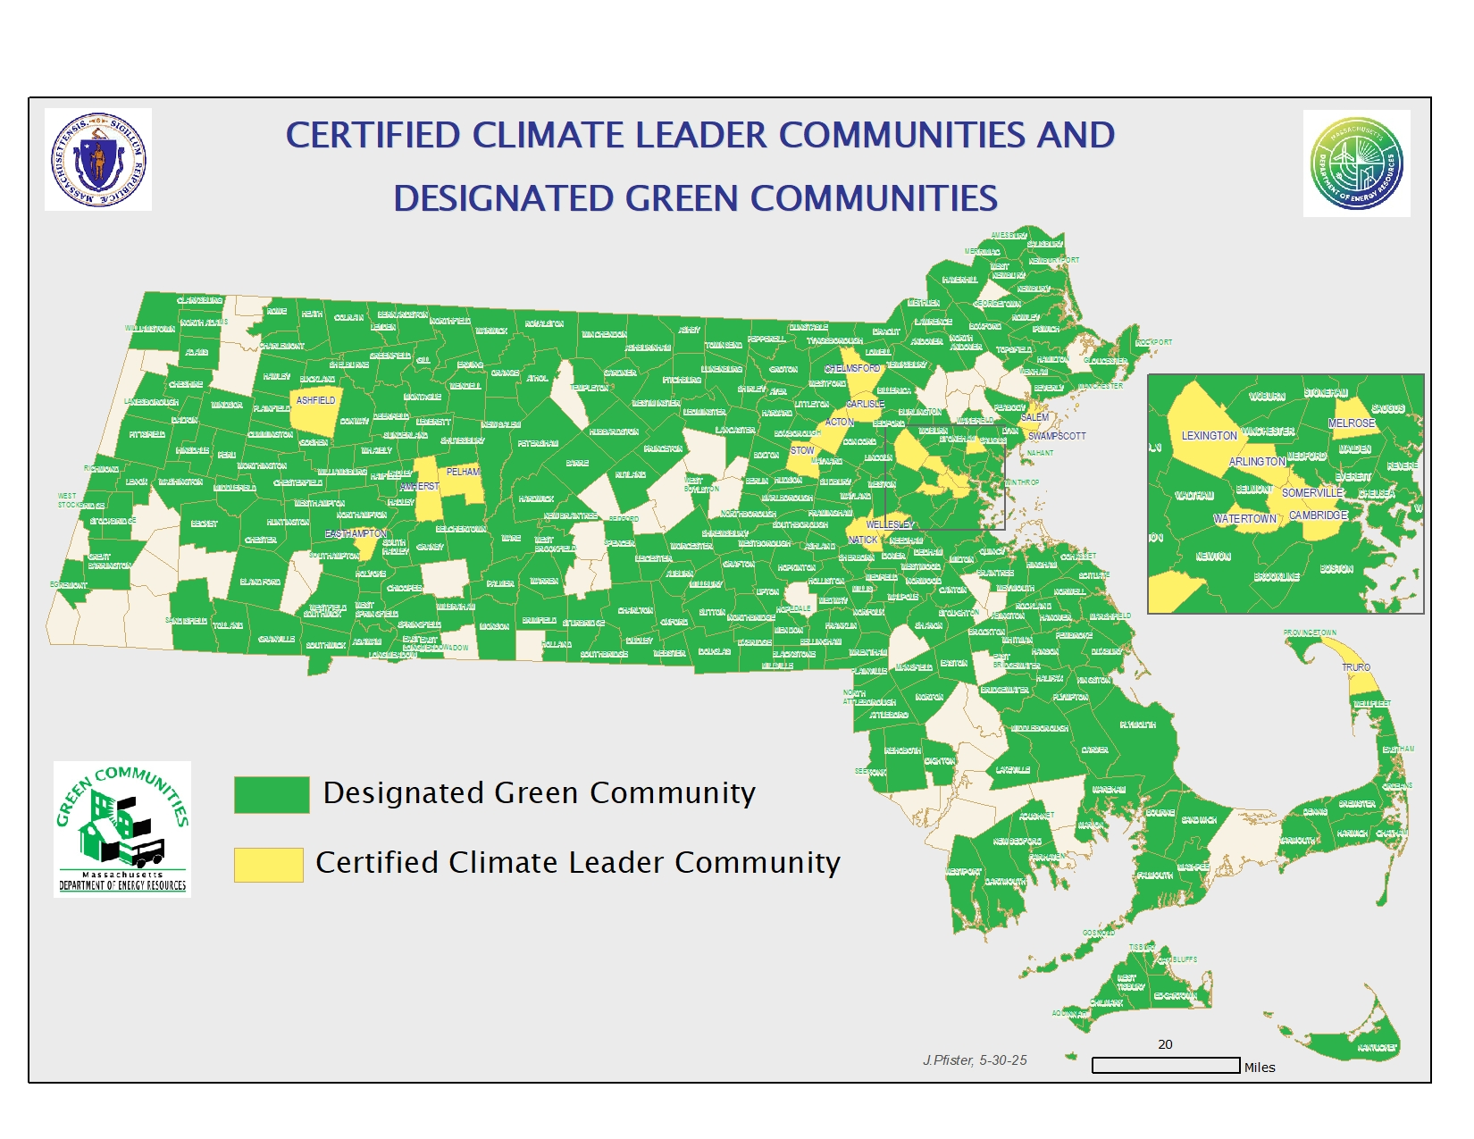

Slide 3
Program Evolution: Green Community to Climate Leader Community
Green Communities Criteria |  | Climate Leaders Criteria
Adopt as-of-right siting for RE/AE generation, R&D, or manufacturing |  | Establish/maintain local committee to advise, coordinate, and/or lead clean energy and climate activities
Adopt expedited permitting process |  | Municipal decarbonization commitment
Create an Energy Reduction Plan to reduce energy use by 20% in 5 years |  | Create Municipal Decarbonization Roadmap with 2030 & 2050 goals
Purchase only fuel-efficient vehicles |  | ZEV-First vehicle policy
Minimize life cycle cost in new construction – a.k.a adopt the Stretch Code |  | Specialized Opt In Code Adoption

Slide 4
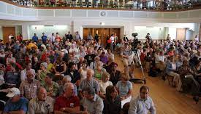

Specialized Code: Adoption process & Timeline
Adopt the Opt-In Specialized Code
Specialized code adoption at the local level, similar to prior stretch code process:
Warrant article
Town Meeting bylaw or City Council ordinance vote
Effective date: Jan 1, or July 1
Recommend 6-12 months after adoption
Notes:
Add bylaw amendment

Slide 5



Climate Leaders Accelerator Grants Up To $1 Million
Available to Certified Climate Leader Communities
Pre-construction
Feasibility studies
Pre-electrification work
Test wells
Procurement documents
Equipment and installation
Buy down the cost of direct ownership or PPA
Quick Win
Solar on newly constructed all-electric schools
Municipal building electrification/decarbonization
Support for on-site solar PV + storage
Support for geothermal for existing buildings and new construction
Notes:
Accelerate Deployment of renewable energy resources
Decrease onsite fossil fuel emissions through facility decarbonization in alignment CECP
Bolster grid and/or resilience benefits from energy storage installation
Reduce electricity and/or operational costs
Direct pay of ITC still an unknown for public entities
Leverage with other $$ sources
Coordinate with MassSave – Deep Energy Retrofit, decarbonization,and New Construction programs
Coordinate with MassCEC Green School Works as needed
HEET/MassCEC Kickstart MA – networked geothermal

Slide 6
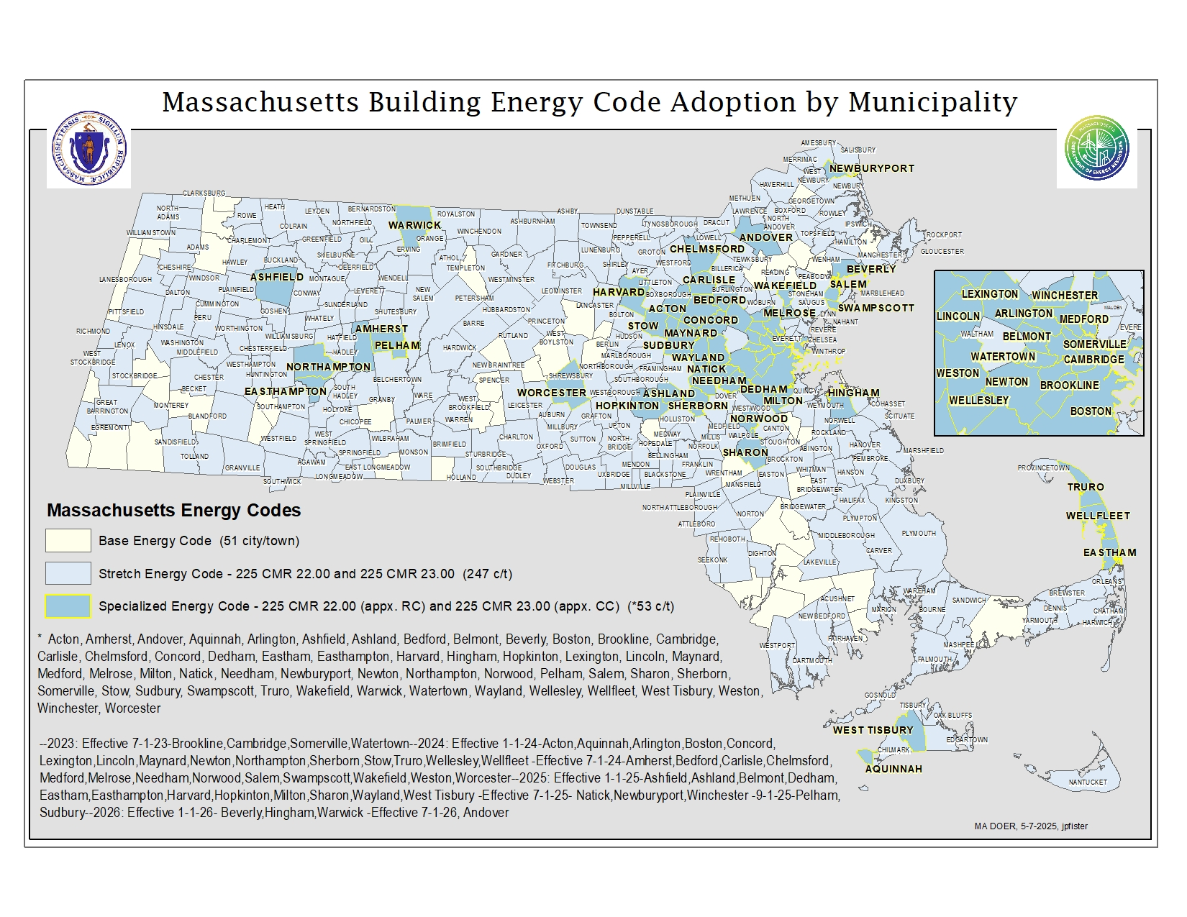
Opt-in Specialized Building Code
Notes:
This map will be continually updated as town meeting votes occur in May.

Slide 7
Base, Stretch, and Specialized – 3 Options
Specialized Code =
Stretch code + appendices RC & CC
55 municipalities so far
New construction only
Orleans is here
246 municipalities
New construction, major renovations/additions
Stretch Code = IECC 2021+ key MA amendments
Base Code = IECC 2021 + MA amendments
50 municipalities
Notes:
The Base Code is IECC 2021 with MA amendments: 780 CMR Chapter 11R (residential) and 780 CMR Chapter 13 (commercial). The 780 CMR 10th Edition is the current building code for Massachusetts.
The opt-in Stretch Code is IECC 2021 with key MA amendments: 225 CMR Chapter 22 (residential) and 225 CMR Chapter 23 (commercial).
The opt-in Specialized Code is IECC 2021 key MA amendments: 225 CMR Chapter 22 + Appendix RC (residential) and 225 CMR Chapter 23 + Appendix CC (commercial).

Slide 8
Specialized vs Stretch code - Residential Low-Rise
Energy Source(s) | Home Size | Stretch code (July 2024) | Specialized Code (Jan 2024)
All Electric New Homes | Any Size home | HERS 45 or Passivehouse Same as Stretch Code | No changes - HERS 45 or Passivehouse
Mixed-Fuel New Homes | Under 4,000 sq ft | HERS 42 | +Solar PV (min 4kw) + wiring for electrification
Multi-family (4+ stories & over 12,000 sf) | 4,000 sq ft and over | HERS 42 | + Solar PV (to net-zero) + wiring for electrification
 | Any | Passivehouse option | + wiring for electrification
Home additions & alterations | Any | Same as Stretch Code
Historic or Existing homes | Any | Energy Code exemption if it would damage the historic fabric of the building

Slide 9
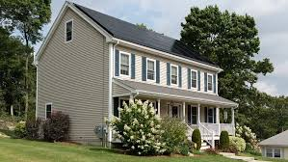
Specialized Residential Code: Solar PV sizing
Mixed-fuel: Solar required for mixed fuel buildings when there is a suitable solar-roof zone ≥ 300 sq. ft. AND at right orientation
Can be ground mounted as long as it’s on-site
Direct ownership or third-party (lease, PPA) allowed
No trees need to be cut down
All-electric: No PV required
Home Type | Solar required
All-electric | No
Mixed-fuel < 4,000 sq. ft. | 4 kW unless Passive House
Mixed-fuel > 4,000 sq. ft. | Enough for net-zero (8+ kw)
Other residential | 0.75 W/sq. ft
Commercial | 1.5 W/sq. ft of three largest floors
Commercial high ventilation | 0.5 W/sq. ft of three largest floors
A 4-kW system would take up about 230 ft² while an 8-kW system would take up 460 ft²

Slide 10
Specialized vs Stretch code – what’s different? Commercial Buildings:
Building Type | Fuel Type | Stretch code (July 2024) | Specialized Code
Schools, Offices, Municipal buildings | All Electric | TEDI or Passive house | TEDI or Passivehouse
 | Mixed Fuel | TEDI or Passive house | TEDI + Solar PV or Passive house + wiring for electrification
Other Commercial (over 20,000 sf) | All Electric | ASHRAE or TEDI or Passive house | ASHRAE or TEDI or Passivehouse
 | Mixed Fuel | ASHRAE or TEDI or Passive house | ASHRAE + Solar or TEDI + Solar or Passive house + wiring for electrification

Slide 11
Specialized vs Stretch code – Multi-family
Building Type | Fuel Type | Stretch code (July 2024) | Specialized Code
New Multi-family (4+ stories & over 12,000 sf) | All Electric | HERS 45 or TEDI or Passivehouse | Passivehouse
Multi-family (4+ stories & over 12,000 sf) | Mixed Fuel | HERS 42 or TEDI or Passivehouse | Passivehouse + wiring for electrification

Slide 12
1 Does the Opt-In Specialized Code apply to existing structures?
Frequently Asked Questions
No. Improvements to existing structures, depending on size, are regulated by the Updated Stretch Code and Base Code.
Frequently Asked Question
2 Will the Opt-In-Specialized Code discourage the creation of affordable housing?
No. Incentives will continue to encourage affordable housing while the Opt-In Specialized Code delivers benefits for residents.
Is it possible to install a gas cooktop?
Yes. This is permitted under the Mixed Fuel pathways.
Why adopt the Opt-In Specialized Code?
The #1 reason is that it requires pre-wiring, avoiding costly retrofits down the road and expediting electrification.
Will the Specialized Code affect the cost of building a new home?
It will not affect the cost of building an all-electric new home.
For new homes that burn fossil fuels, it will add the cost of prewiring for future electrification any appliance that burns fossil fuels and the cost of investing in a solar-electric system. (If solar is feasible.)

Slide 13
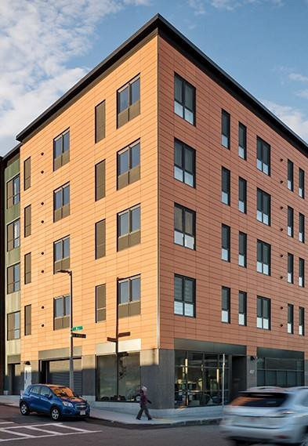


Passive House Building Standards
What is Passive House?
Passive House is third party building verification program with two options for certification (PHIUS and PHI)
These certification standards set energy performance and building envelope air-tightness requirements
Can be any type of building
Does not require all-electric or net zero
How do Passive House Buildings Perform?
Heating loads can be reduced by 90% or more compared to a typical building
Overall energy demand can be reduced by 60% or more
Significant improvement in indoor air quality and occupant comfort
The Distillery, South Boston
Passive House Massachusetts | www.PHMass.org

Slide 14





Affordable Housing & Passive House Are a Great Mix
Lower utility costs for tenants or for the developer
Higher level of indoor air quality leading to lower healthy impacts from indoor
pollutants
Improved occupant comfort, constant room temperatures, and elimination of air
drafts
Longer lasting construction with less maintenance needs (and costs)
Brewster Woods Community Housing - Building 40 — Passive House Massachusetts
The Kenzi, Roxbury
Passive House Massachusetts | www.PHMass.org

Slide 15
Multi-family incentives
Mass Save Passive House Incentives
Point of construction | Activity | Incentive | Maximum
Pre-construction | Feasibility study | Up to 100% | $5,000
 | Energy modeling | 75% | $500/unit up to $20,000
 | Pre-certification | $750/unit | None
Post-construction | Certification | $3,000/unit | None
Additional opportunities:
PH apartments are awarded 8 points in LIHTC applications
PH certifications requires projects that are eligible for Energy Star/ZER to get these certifications, making it easier to apply for the federal credit.
Federal tax credits (45L) | Regular (per unit) | Prevailing wage (per unit)
Energy Star Program | $500 | $2,500
Zero Energy Ready | $1,000 | $5,000

Slide 16
Lisa Sullivan
Green Communities Southeast Regional Coordinator
Cell: (617)312-4018
Email: Lisa.m.sullivan@mass.gov
www.mass.gov/orgs/green-communities-division
Mike Rossi, PSD Consulting, Email: mrossi@psdconsulting.com

